Slide 1

Vehicles as Cover

Slide 2

Call for Service
You are dispatched to a family disturbance in which an occupant is armed and shots have possibly been fired. You park two houses down and approach cautiously. As you walk across the neighbors driveway, the suspect begins shooting at you. You are near the neighbors vehicle and not near other cover. Describe your cover options.
(Discuss)

Slide 3
Vehicles as Cover
Remember, if you can see the threat, then your first priority of cover is accurate return fire (ABC’s of cover: accurate return fire; ballistic armor; hard cover…in that order)
Return fire as you move to the front of the neighbor’s vehicle
Avoid the urge to run up and hug the vehicle for cover.
Remain at least 6’ away from the vehicle as you provide directed fire.

Slide 4
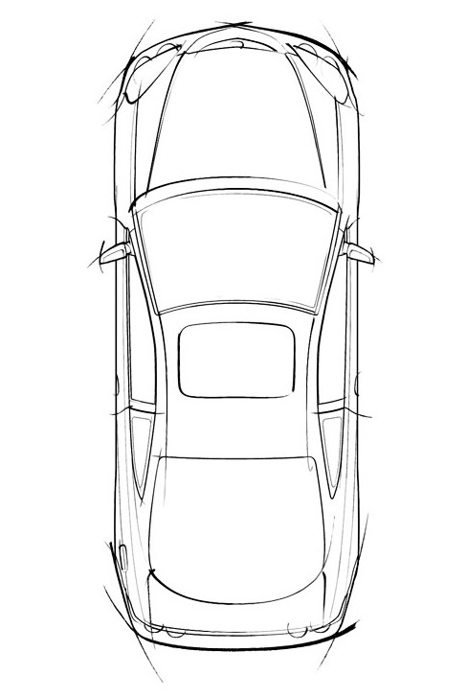
Vehicles as Cover
Back off 6+ feet. This allows you to see the threat and prevent being flanked.

Slide 5
4 Cornerstones
Wear your armor
Buckle up
Slow down
Stay Fit

