Slide 1


Retired 2003
Hurst Police Department over 27 yrs.
35 years experience
Past President Texas Division International
Association Identification 1985-86
Founder and Past President
Texas Association Property & Evidence Inventory
Technicians (T.A.P.E.I.T.)
1997-2002

Slide 2
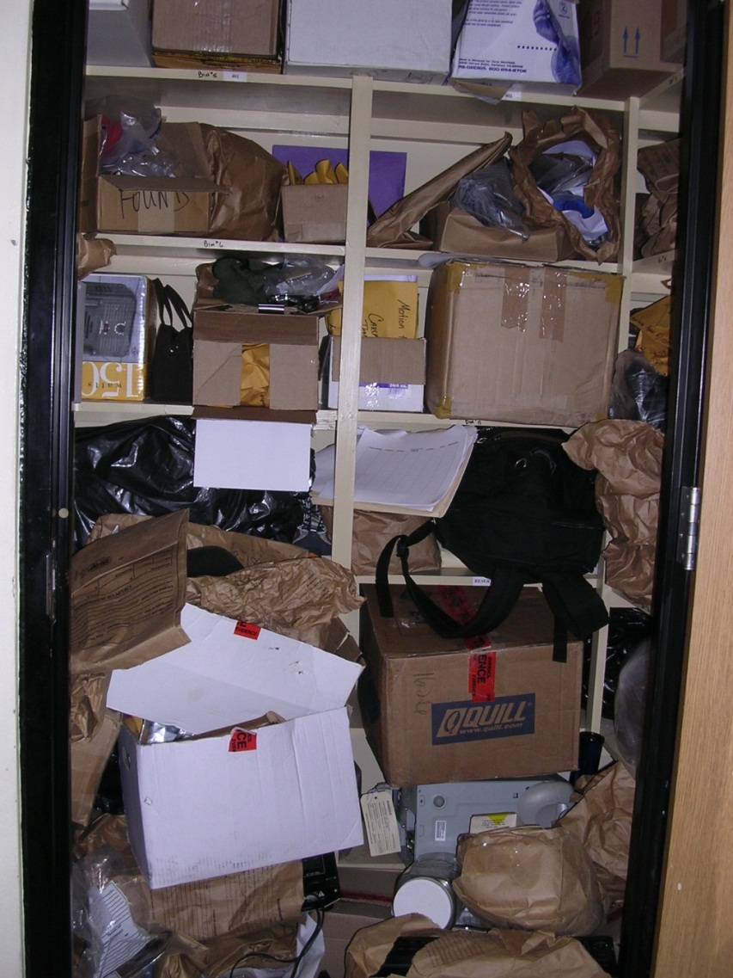
HOW DO WE FIX THIS!!!
DISTRICT ATTORNEY, COUNTY JUDGE, MUNICIPAL JUDGE PROPERTY
PROPERTY ROOM IS IN PROCESS OF BEING CLEANED.
DO WE HAVE LOG OR INVENTORY OF ITEMS?
IF SO THEN WE HAVE SOMETHING TO COMPARE ITEMS
Notes:
Visit with your DA, County Judge, Municipal Judge make them aware the property room is going to be purged, inventoried and will be needing their assistance in signing orders on some things. Most of the time they will be more than happy to help knowing this area is being cleaned up.
Do we have a log?
If we have a log to verify what we have? Then step one is get it out so we can verify what we have. No log same thing sort.

Slide 3
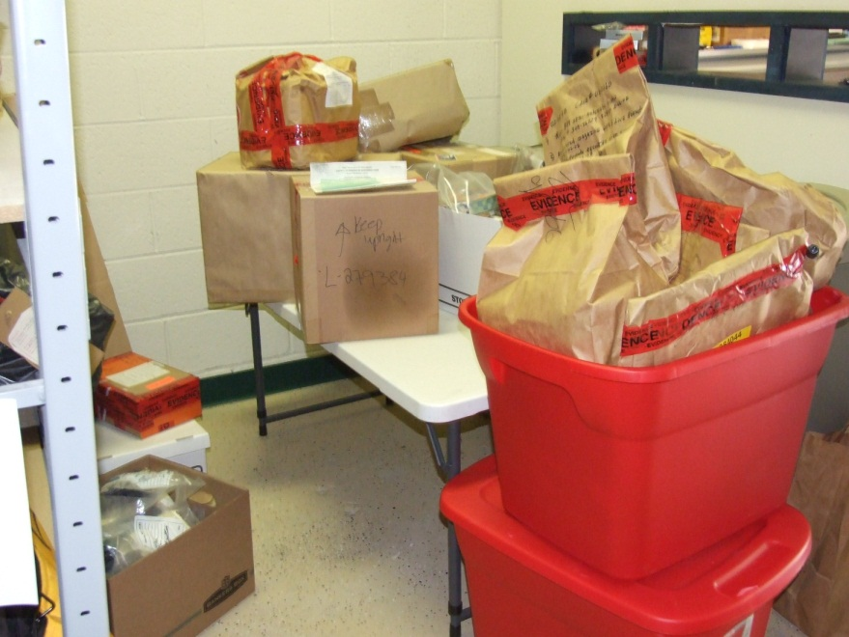
SEPARATE ITEMS BY TYPES
OF OFFENSES AND BY CASE NUMBERS
RESEARCH IS the CASE STILL ACTIVE?
HAS THE STATUTE OF LIMITATIONS RUN?
DO WE NEED A COURT ORDER ON THE ITEM.
Notes:
Then separate items in accordance with the types of offenses makes it easier to locate a case.
Place items in order by YEARS and case numbers if possible while we are separating.
Have someone usually an investigator can research if it is not visible by looking at the evidence as to whether charges were filed.
Then we will look at Chapter 12 CCP if no charges were filed then has the statute run if so then we place that in the area of obtaining a court order if needed. In many of the cases where no charges were filed the Municipal Judge or JP will be the one to sign order if an order is needed.

Slide 4
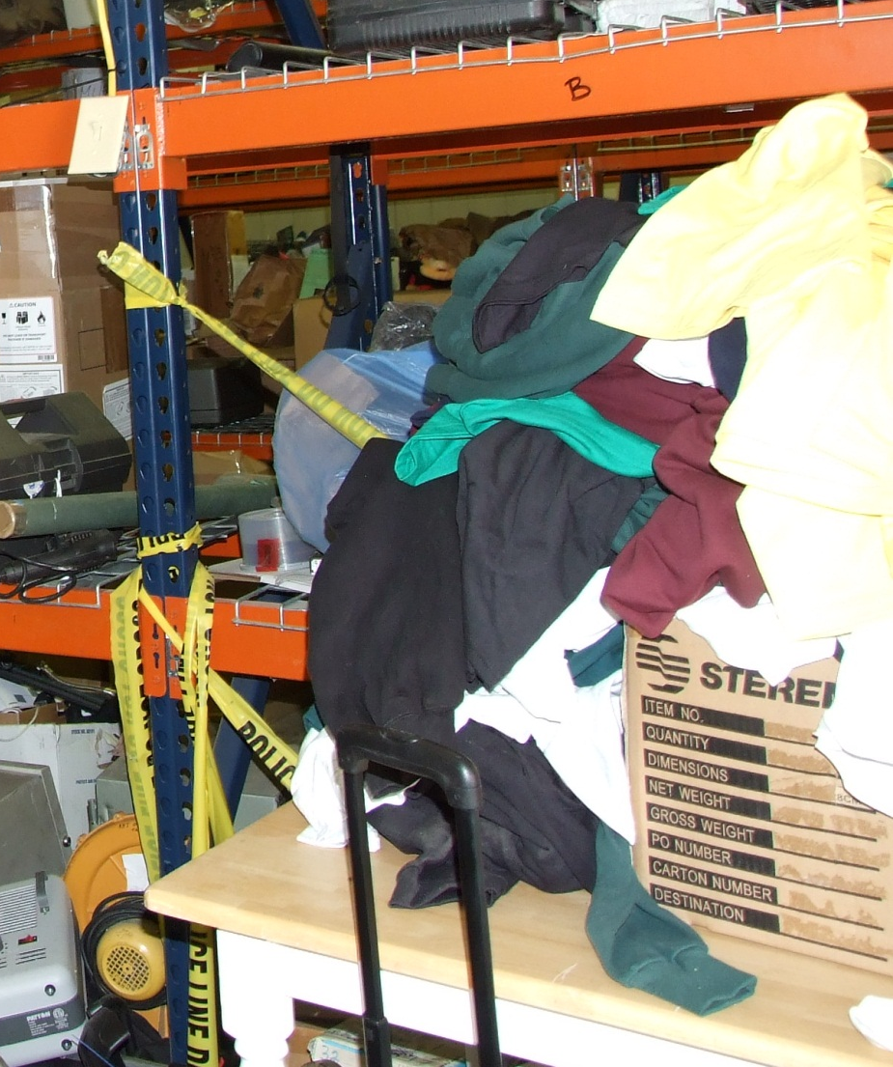
VALUE & OWNER
DETERMINE VALUE
DO WE KNOW THE OWNER
IF SO CERTIFIED LETTER
90 DAYS TO CLAIM
18.17 CCP
Notes:
Determine is there a value?
Do we need to notify an owner?

Slide 5
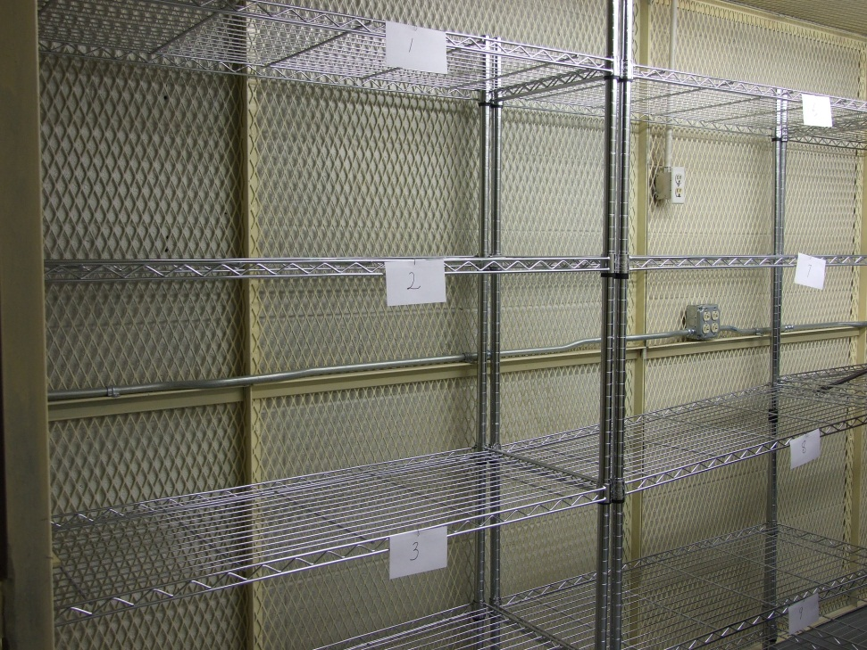
Organization of the room
ORGANIZE THE PROPERTY BY TYPES OF CRIMES
HOMICIDES BACK OF ROOM
ITEMS MOVE QUICKLY FRONT OF ROOM

Slide 6
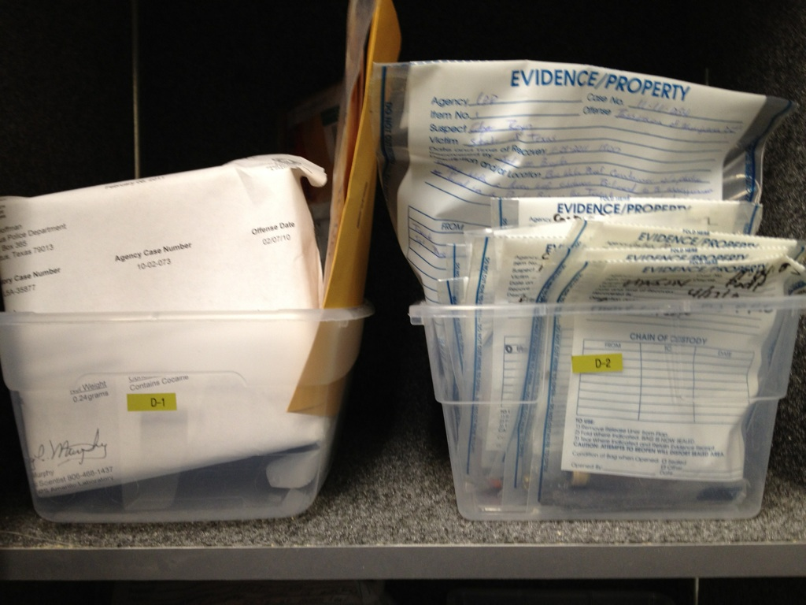
PACKAGED ITEMS
PACKAGED TO MAINTAIN CHAIN OF CUSTODY
VERIFY WHICH ITEMS TO KEEP AND ITEMS TO DISPOSE OF
Notes:
Look at these items are they packaged in a way to maintain the chain of custody?
Are they just thrown into the dungeon?
We have verified these items as to keep or dispose.

Slide 7
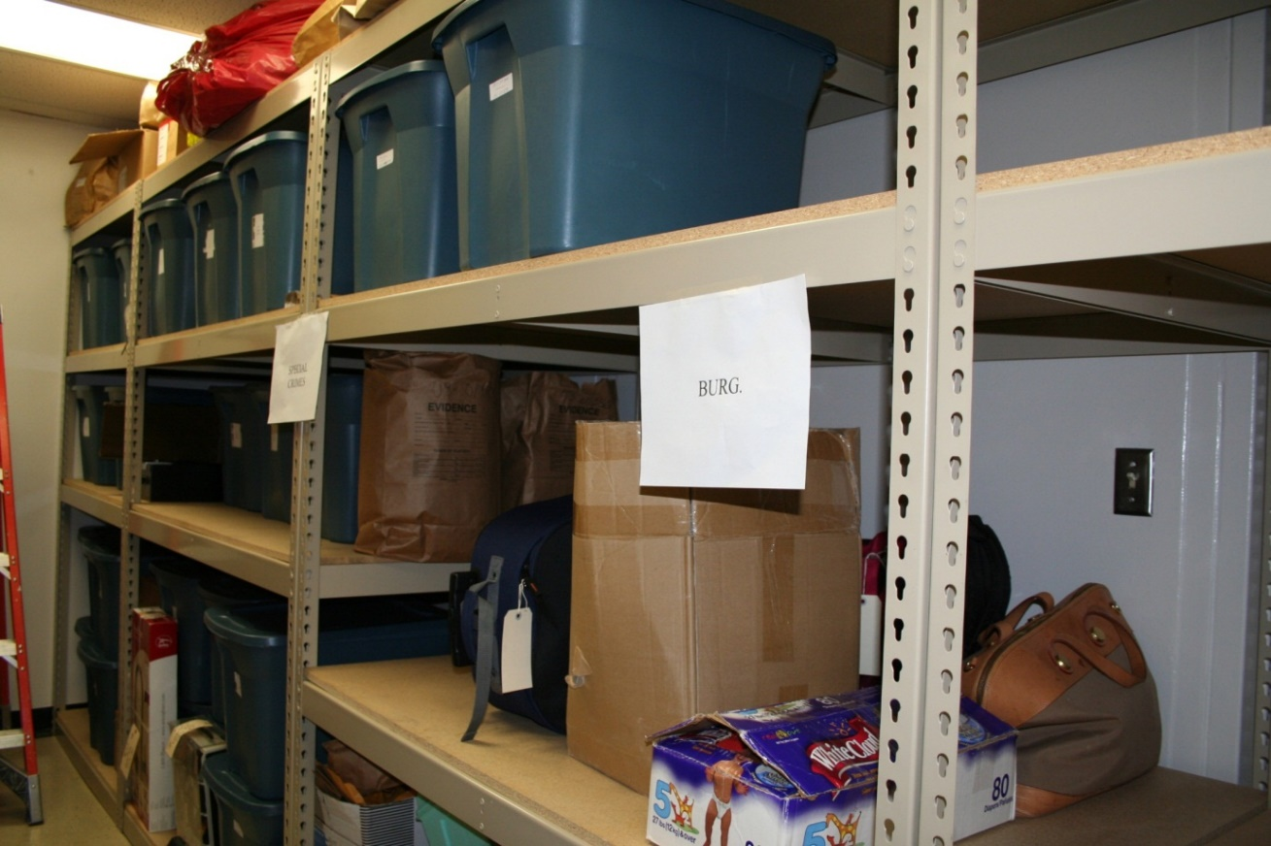
Research MATCH PROPERTY TO CASE NUMBERS
DOCUMENTING NEW LOCATION
CREATING A COMPLETE INVENTORY
Notes:
Organize the property room by types of crimes and or evidence? I prefer types of crimes.
The items we can match to case and needs to be retained as evidence is then moved to the area in the property room where it is placed in order by your case numbers or tag numbers as close as possible.
Place new location in computer system, spread sheet or log of some type.

Slide 8
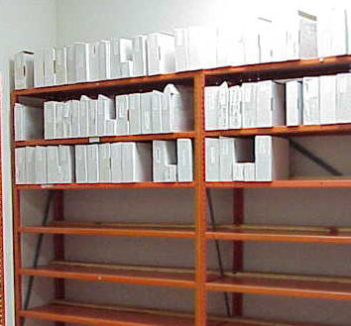
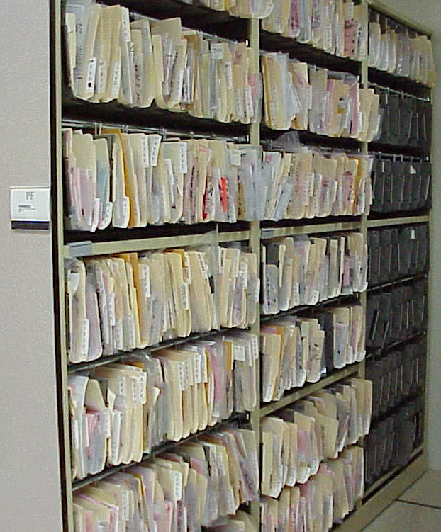
HAND GUNS IN ORDER BY CASE NUMBERS
PF PAPER FILES IN ORDER BY CASE NUMBERS
WHEN YOU ARE WORKING CASE DISPOSITIONS THEY WILL AUTOMATICALLY ROTATE UP IN ORDER
Notes:
Keep it simple and easy to retrieve, never place items on top of each other that you must move several boxes are items to retrieve the item needed.
We have all items relocated that we could identify with a case and the case was still active.

Slide 9
DNA EVIDENCE MUST BE RETAINED
AT A CONSTANT ROOM
TEMPERATURE WITH A
NEW STATUTE OF 40 YEARS
SB1616 WAS PASSED IN LAST LEGISLATURE
A TEAM CONSISTING OF REPRESENTATIVES FROM INNOCENT
PROJECT, DPS AND T.A.P.E.I.T.
HAVE UNTIL 2013 TO DEVELOP PROCEDURES

Slide 10
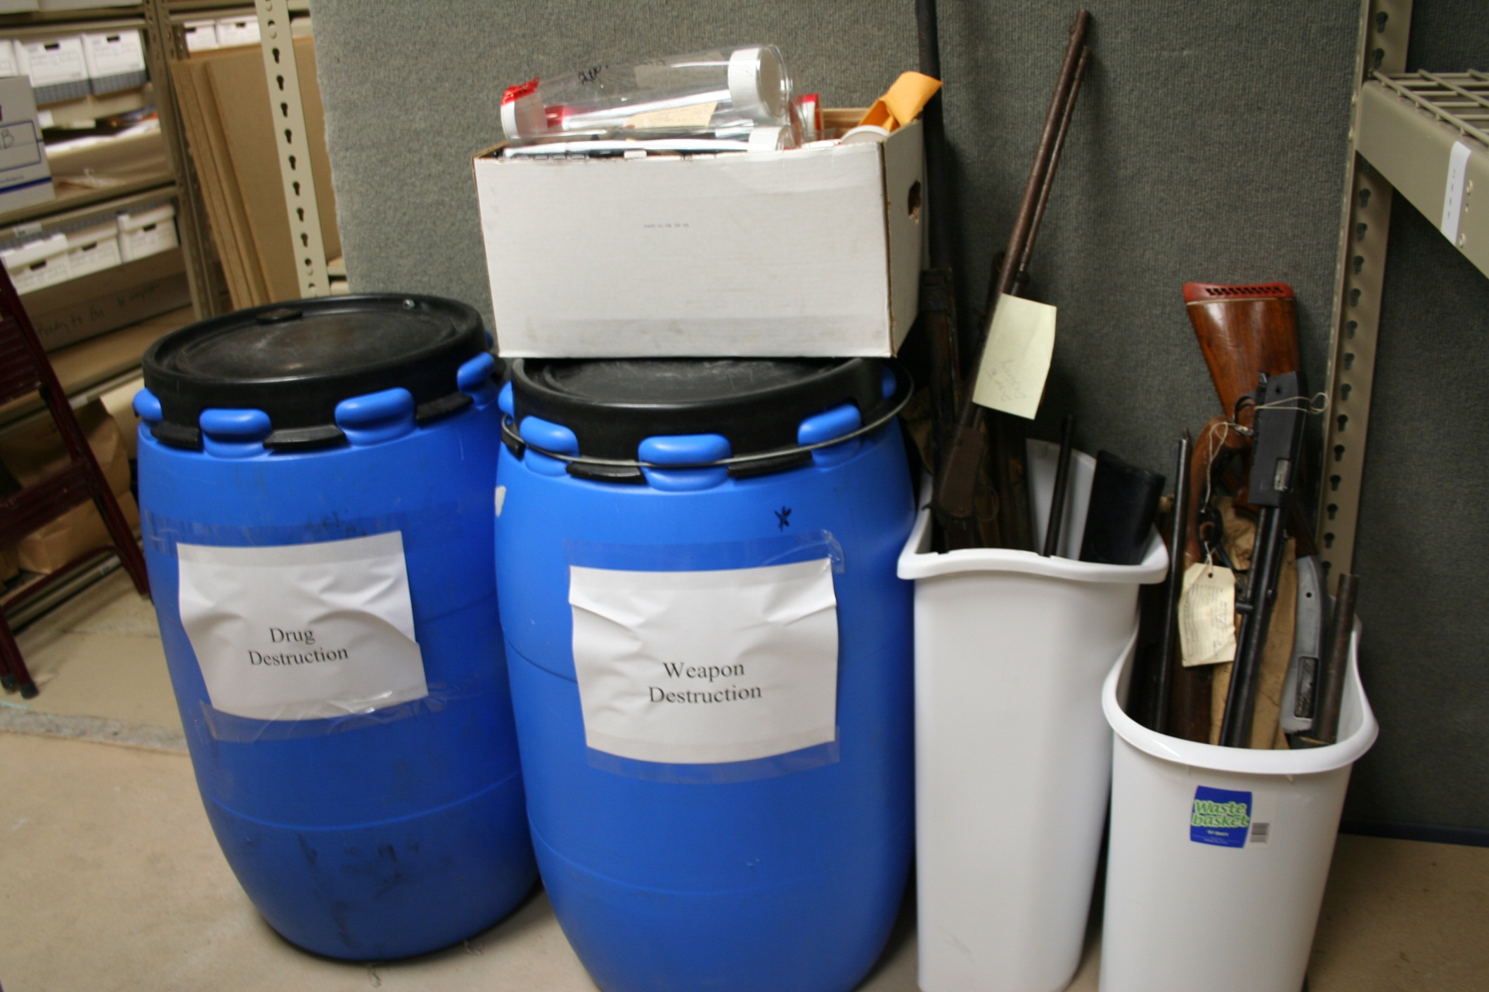
Notes:
Cases that we can not identify case numbers or any form of identifying numbers to place item with a case. Separate these items out so a court order can be obtained for those items.
Donate items that you can to your local shelters like clothing this is in accordance with 18.17 of the ccp
Make an inventory list of all items to be disposed of separating by types of offense and degree of offenses.
In counties across the state a blanket order will be signed by most judges when they have been made aware of the cleaning process.
However some you must list weapons individually with notation of research and case information if possible.
Items that the owners may be known try calling before sending those expensive certified letters. Article 18.17 of the ccp says you must send a certified letter to the owner giving them 90 days to pick up items.
If the owners do not claim items after 90 days they may be disposed of in accordance with 18.17 ccp
If the owner is unknown and the value is under $500 you hold 30 days and dispose.
If the value is over $500 must be advertised 14 days prior to the sell.
.

Slide 11
HOW DO WE DISPOSE OF ITEMS
WEAPONS CHOP SAW , CUTTING TORCH,
EMPIRE DISPOSAL IN FORT WORTH , STEEL
MANFACTURING
DONATE CLOTHING, BICYCLES, MISC. ITEMS
TO YOUR LOCAL SHELTERS OR NOT FOR PROFIT ORGANIZATIONS
IN ACCORDANCE WITH 18.17
DRUGS MUST BE DESTROYED IN ACCORDANCE WITH EPA GUIDELINES
EMPIRE DISPOSAL FORT WORTH, SHARPS @ CARTHAGE, ANAHUAC NEAR HOUSTON, DRUG TERMINATOR
USE DUMPSTERS THAT ARE SECURE
ACQUIRE COURT ORDERS AND OR DESTROY ITEMS
Notes:
Weapons destroy in a way that the serial number is destroyed.

Slide 12
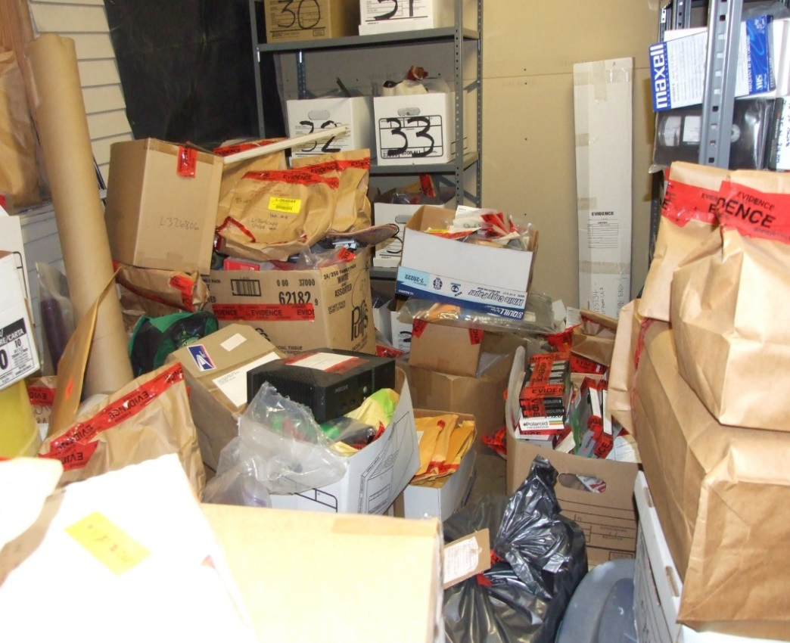
FROM THIS
RESEARCH EVERY CASE
NEVER DISPOSE UNTIL ALL DEFENDANTS HAVE A FINAL DISPOSITION
Notes:
RESEARCH TAKES TIME
Research Never dispose until all Defendants have a final DISPOSITION

Slide 13
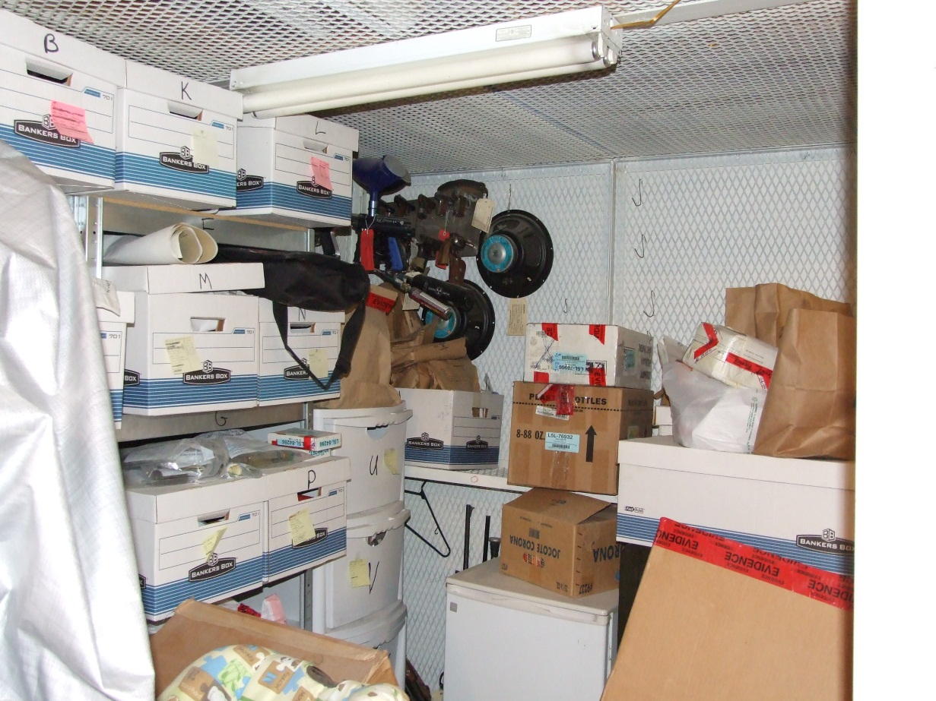
INVENTORY ALL ITEMS
COURT ORDERS
CERTIFIED LETTERS
Notes:
Inventory Active cases to be Disposed of even if you must list one gray in color old handgun with no markings visible.
Acquire Court Orders from the appropriate court when needed
Send Certified Letters
Post in Local News Paper if the value is over $500. (this amount may change next legislature)
Destroy items that can’t be donated and do so as soon as possible in accordance with EPA guidelines.
Keep all documentation and or photos of all releases, donations and destructions.
Property Room . Com

Slide 14
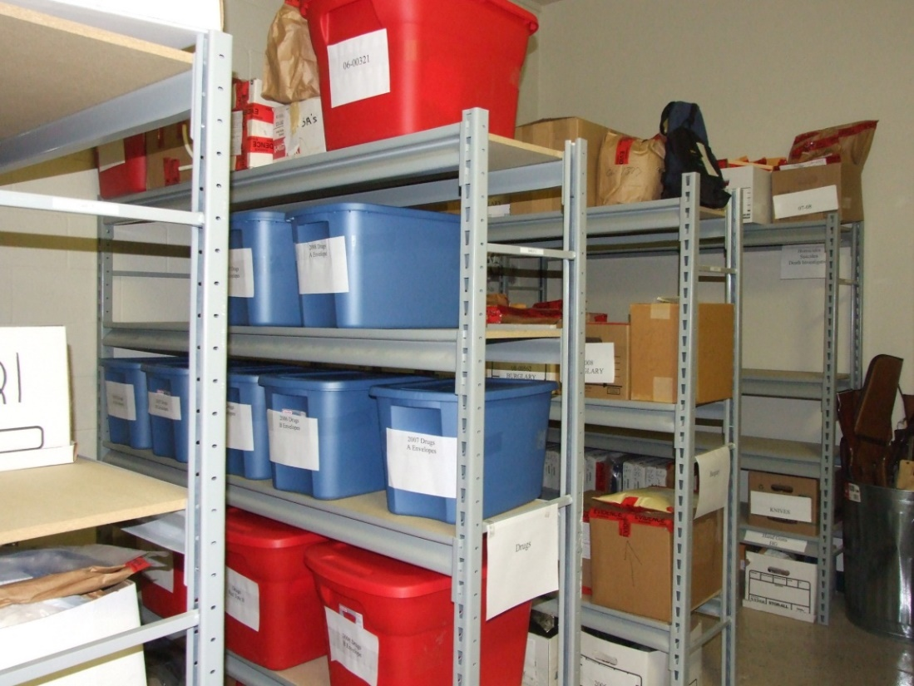
TO THIS
PROCEDURAL MANUAL FOR THE OPERATION OF THE PROPERTY ROOM
Notes:
PROCEDURAL MANUAL FOR THE PROPERTY ROOM STEP BY STEP
You have a question call me or email any time

Slide 15
